Slide 1
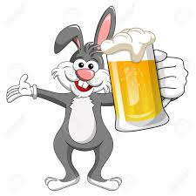
Bar Hopper
Jacqueline Ramos, Will DeRoberts, Mark Paris, Diaeddin Motan

Slide 2
Our Customers
Bar Hopper is the waze for nightlife! Find the grooviest club in town by collaborating with your friends to tag nightlife spots with real-time attributes such as ‘long line’ or ‘empty’.
The Brunch Crowd
The College Crowd
The Rowdy Crowd
The ‘Lana Del Rey’ Crowd
Shots on shot (vaccinated) Crowd
The 2am Crowd
The 9am Crowd
Karens

Slide 3
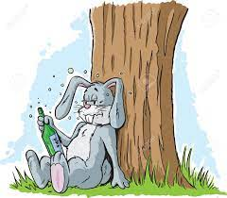
Impact on our Customers
We all need a little more joy these days. Long lines and suboptimal bar atmosphere has a profound impact on our customer’s happiness.
By helping them find the right bar, we empower our customers to make choices that help them belong and bring them together at the right bar for them

Slide 4



How we’re making the world a better place!
After a year and a half of staying inside and having a non-existent social life, we are all ready to ‘hop’ back to it!
Bar Hopper can ease the transition back to nightlife during covid era AND improve the experience by reducing frustration and increasing satisfaction/comfort!
With Bar Hopper, you’ll be able to select the bars that best fit your mood and time frame. Goodbye waiting 30 min for a bar that is so not your vibe!
With Bar Hopper, you’ll be able to select the clubs that align with your covid health & safety standards. Goodbye making it all the way out to a club that isn’t checking vaccination cards!

Slide 5
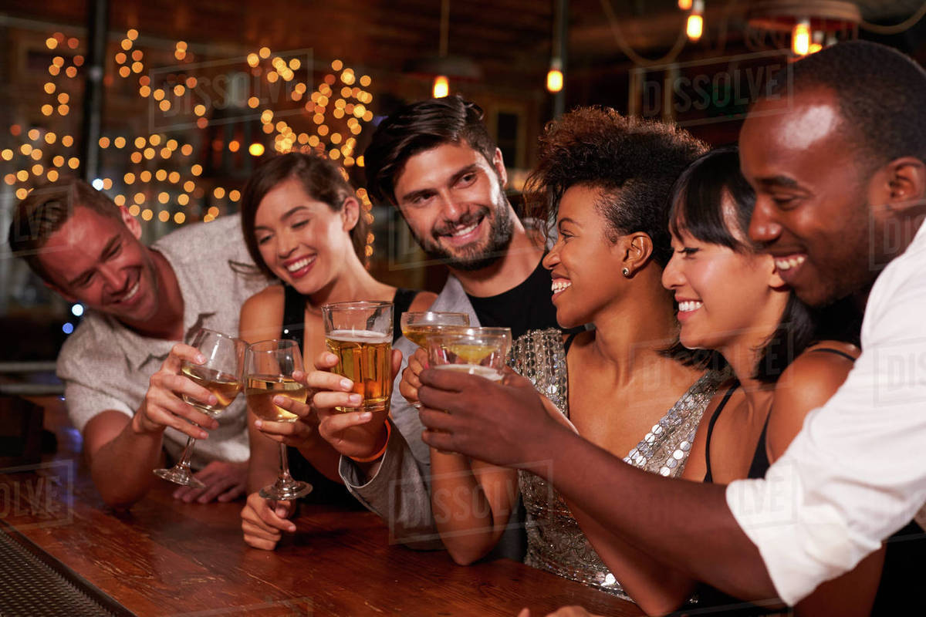
“Chugging” forward
Over the course of the pandemic, we have learned the true value of human connection and social activities.
So let’s safely prioritize and maximize our night lives!

Slide 6

Major Features
Display recent status (within 2 hours)
User verification of recent status (quick yes/no question to ‘long wait time?’)
Search for a bar
View hours of operation, phone #
See it’s location on a map
View COVID requirements (e.g. vaccine required, masks required, reduced capacity)
Rating (‘Hot Bar!’)

